Slide 1
Decoder

Slide 2
Decoder
2-to-4,
3-to-8,
…
n-to-2^{n}
A
B
C
O₀
O₁
O₂
O₃
O₄
O₅
O₆
O₇
O₀
ABC
O₁
ABC
0
0
0
1
0
0
0
0
0
0
0
A
S₂
O₂
ABC
0
0
1
0
1
0
0
0
0
0
0
B
S₁
3:8
O₃
ABC
0
1
0
0
0
1
0
0
0
0
0
C
dec
O₄
ABC
S₀
0
1
1
0
0
0
1
0
0
0
0
O₅
ABC
O₆
ABC
1
0
0
0
0
0
0
1
0
0
0
O₇
ABC
1
0
1
0
0
0
0
0
1
0
0
1
1
0
0
0
0
0
0
0
1
0
1
1
1
0
0
0
0
0
0
0
1
Enb

Slide 3
Decoder
2-to-4,
3-to-8,
…
n-to-2^{n}
E
A
B
C
O₀
O₁
O₂
O₃
O₄
O₅
O₆
O₇
0
X
X
X
0
0
0
0
0
0
0
0
O₀
ABC
O₁
ABC
1
0
0
0
1
0
0
0
0
0
0
0
A
S₂
O₂
ABC
1
0
0
1
0
1
0
0
0
0
0
0
B
S₁
3:8
O₃
ABC
1
0
1
0
0
0
1
0
0
0
0
0
C
dec
O₄
ABC
S₀
1
0
1
1
0
0
0
1
0
0
0
0
O₅
ABC
O₆
ABC
1
1
0
0
0
0
0
0
1
0
0
0
O₇
ABC
1
1
0
1
0
0
0
0
0
1
0
0
1
1
1
0
0
0
0
0
0
0
1
0
1
1
1
1
0
0
0
0
0
0
0
1
Enb

Slide 4
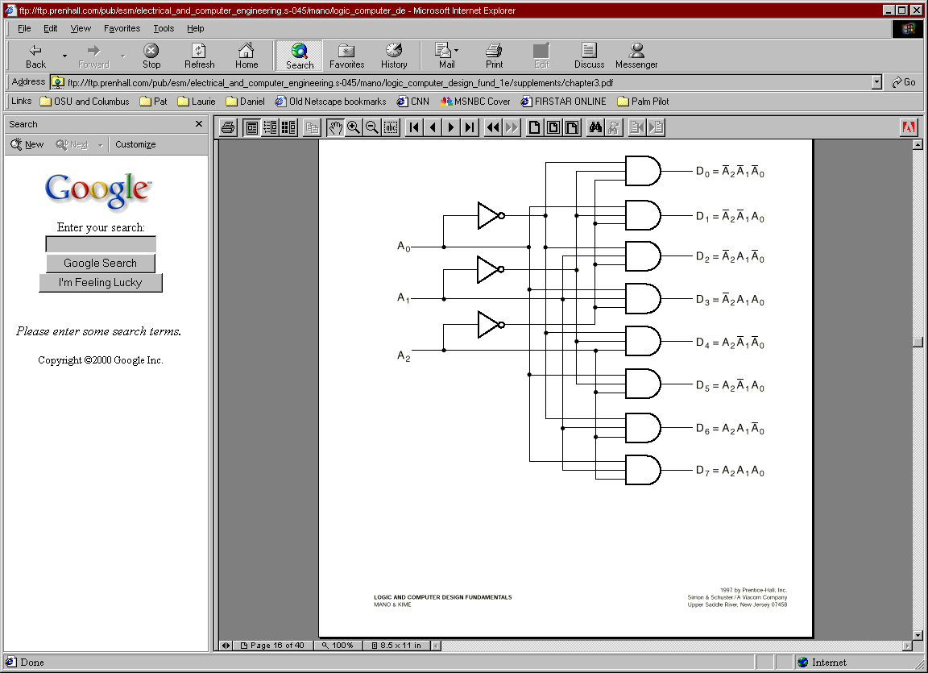
Decoder
E?

Slide 5
Design Using Decoder
Applications:
Implementing General Logic
Any combinational circuit can be constructed using decoders and OR gates!
Example:
0
1
F1 = A' B C' D + A' B' C D + A B C D
F2 = A B C' D' + A B C
F3 = (A' + B' + C' + D')
2
3
A
S₃
4
S₂
5
B
6
4:16
7
C
S₁
dec
8
9
D
S₀
10
1
1
12
13
14
15
Enb

Slide 6
Design Using Decoder
Applications:
Implementing General Logic
Any combinational circuit can be constructed using decoders and OR gates!
Example:
0
A
‘B’C’D’
1
A
‘B’C’D
F
F1 = A' B C' D + A' B' C D + A B C D
F2 = A B C' D' + A B C
F3 = (A' + B' + C' + D')
2
A
‘B’CD’
1
3
A
‘B’CD
A
S₃
4
A
‘BC’D’
S₂
5
A
‘BC’D
B
6
A
‘BCD’
4:16
7
A
‘ BCD
C
S₁
dec
8
A
B’C’D’
F
9
A
B’C’D
2
D
S₀
10
A
B’CD’
1
1
A
B’CD
12
A
B C’D’
13
A
B C’D
14
A
B C D’
F
15
A
B C D
3
Enb

Slide 7
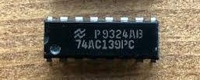
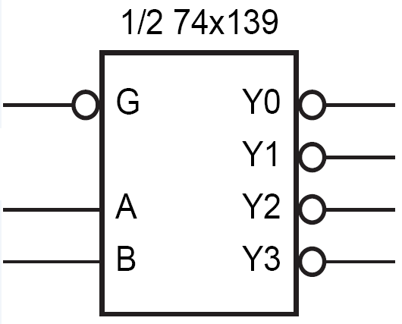
Active Low
Decoder with
Active Low Enable
Active Low Outputs
G | A | B | Y₀ | Y₁ | Y₂ | Y₃
1 | X | X | 1 | 1 | 1 | 1
0 | 0 | 0 | 0 | 1 | 1 | 1
0 | 0 | 1 | 1 | 0 | 1 | 1
0 | 1 | 0 | 1 | 1 | 0 | 1
0 | 1 | 1 | 1 | 1 | 1 | 0

Slide 8
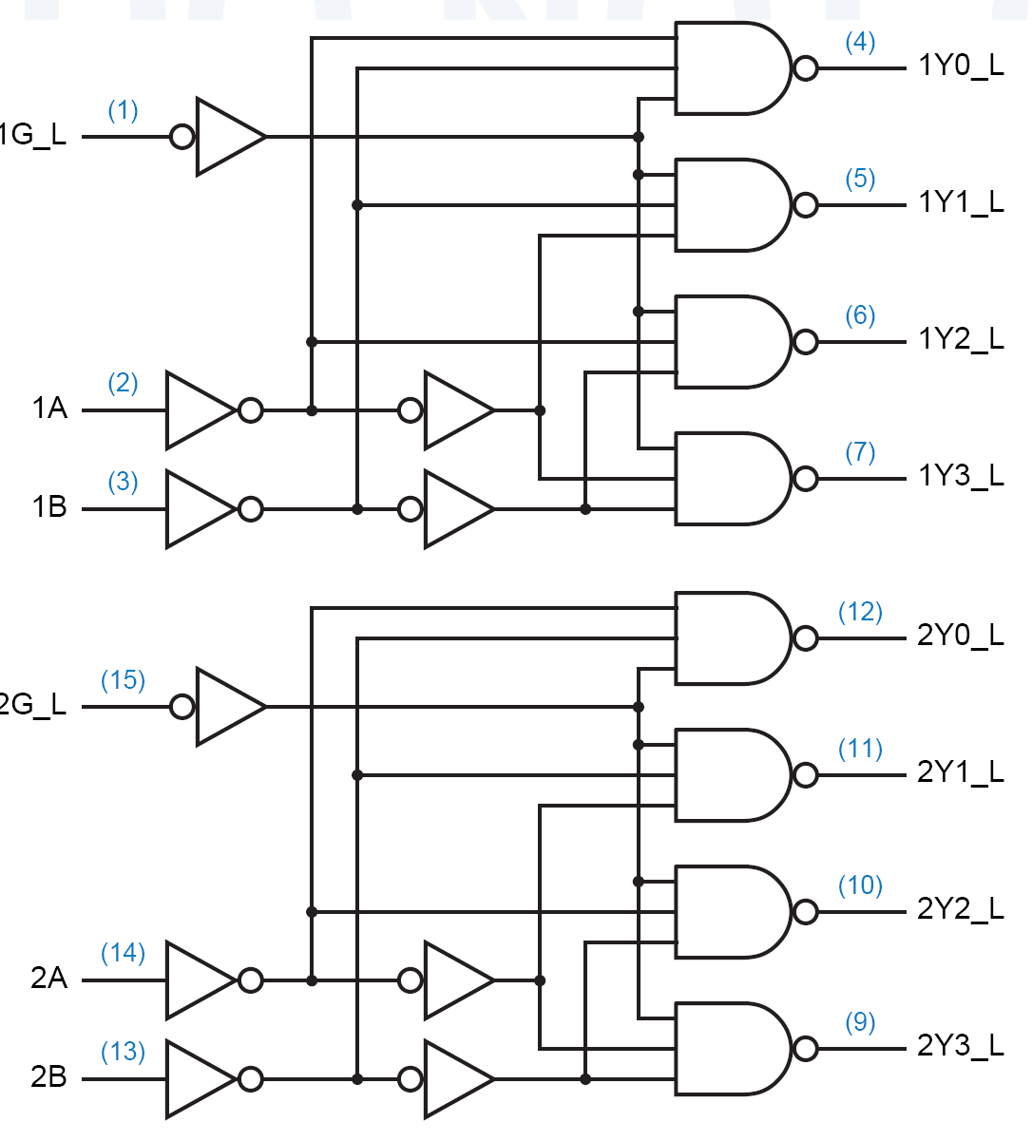
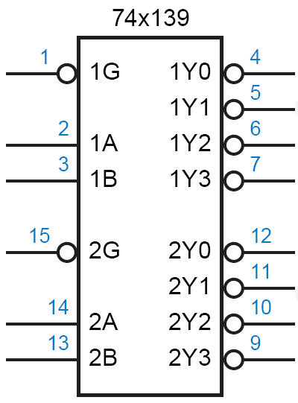
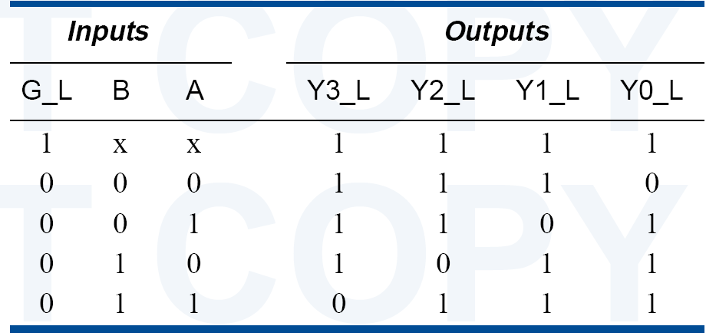
74x139 dual 2-to-4 decoder

Slide 9
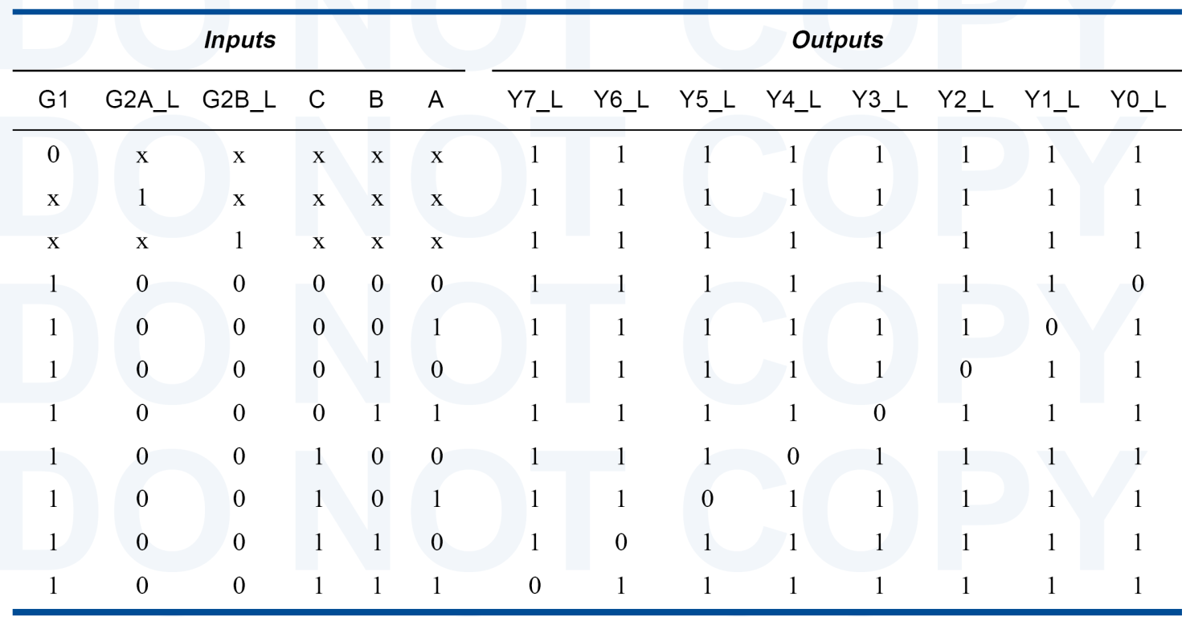
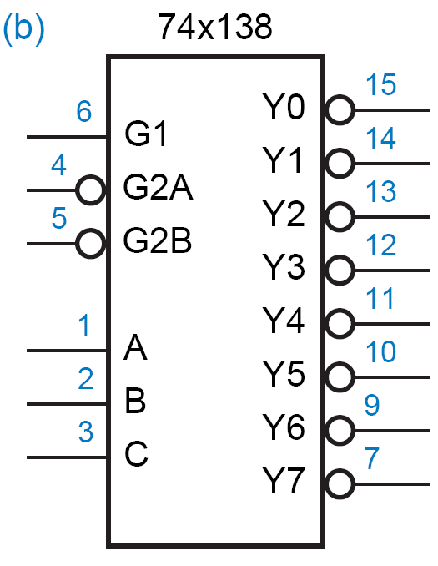
74x138 3-8 Decoder

Slide 10
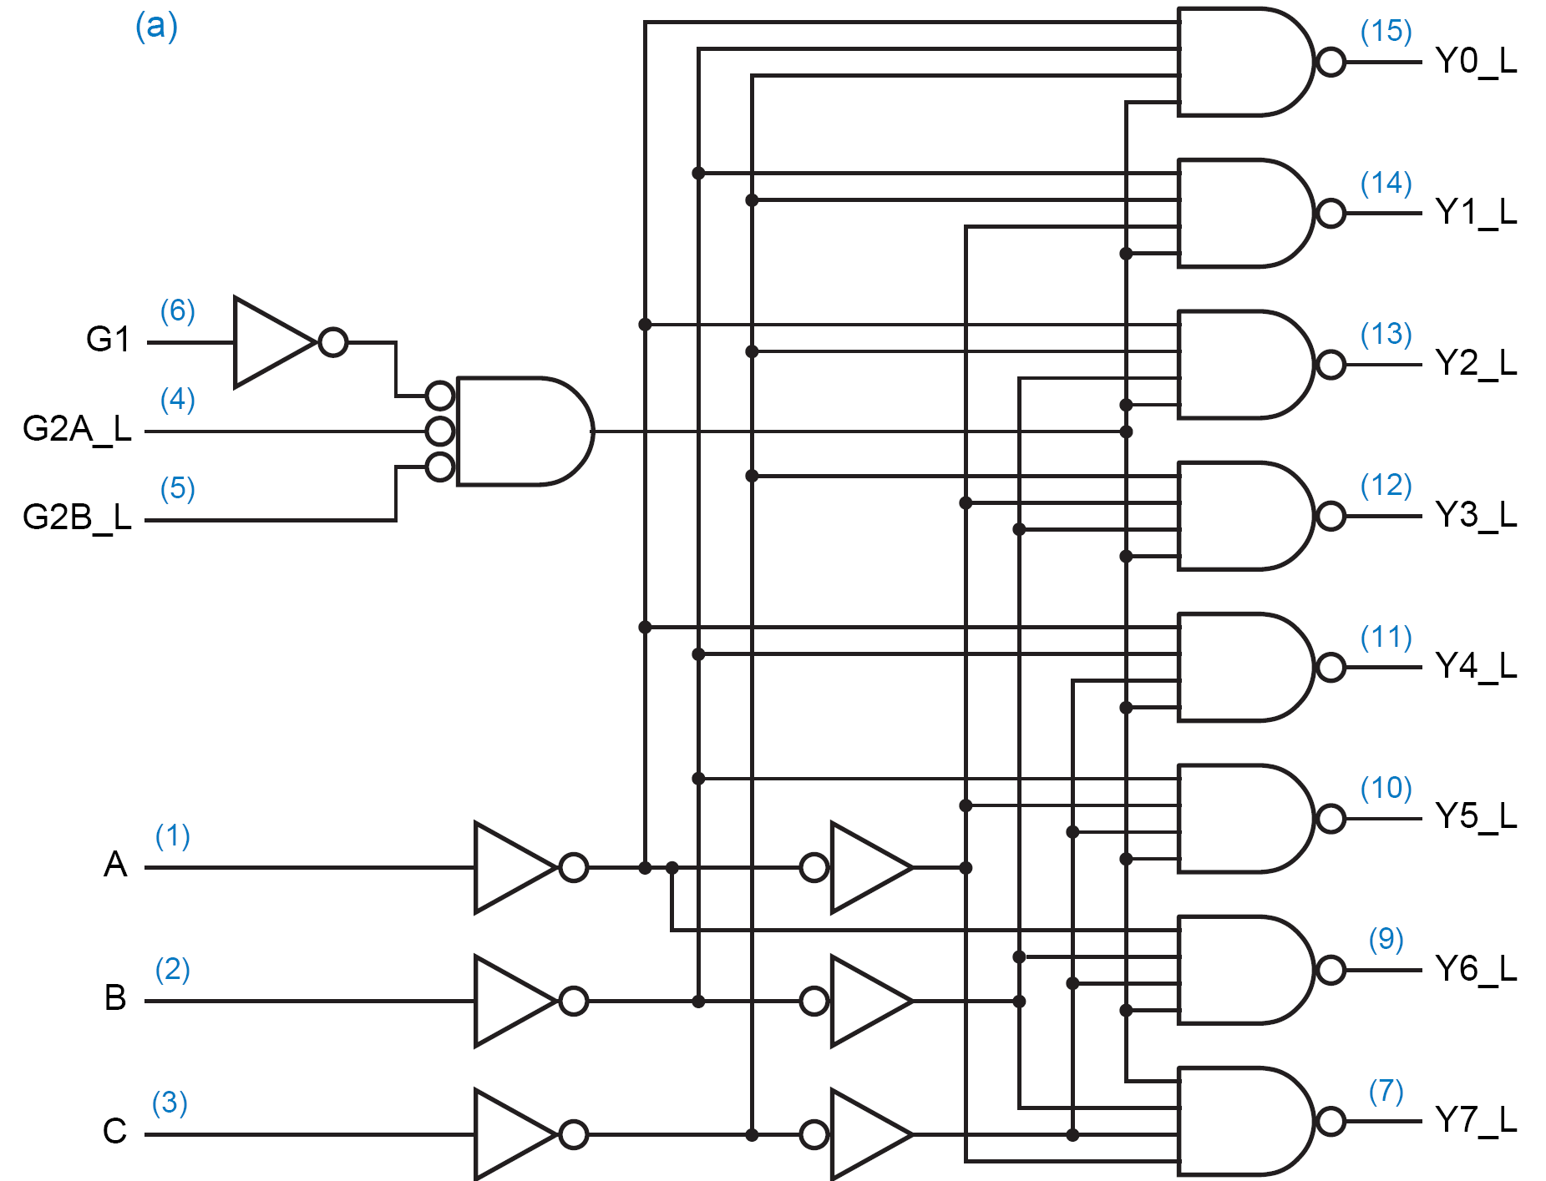
74x138 3-8 Decoder

Slide 11
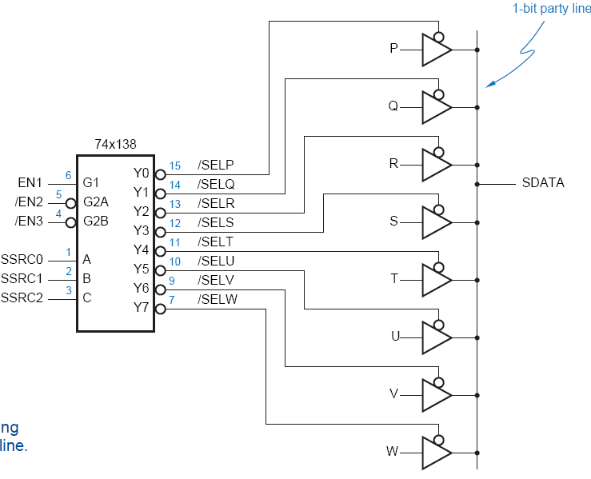
Using 3-State Buffers
Can use 3-state buffers to share a single line for several devices.
Decoder guarantees that no two buffers are on simultaneously.

Slide 12
Decoders
Can build a decoder by smaller decoders
A
O₀
0
S₂
O₁
1
B
S₁
O₂
3:8
O₃
2
S₀
dec
O₄
3
O₅
A
S₃
4
O₆
5
Enb
O₇
B
S₂
6
4:16
7
C
S₁
dec
8
C
9
O₀
D
S₀
10
S₂
O₁
1
1
O₂
12
S₁
3:8
O₃
13
S₀
dec
O₄
14
O₅
15
D
Enb
O₆
O₇
Enb

Slide 13
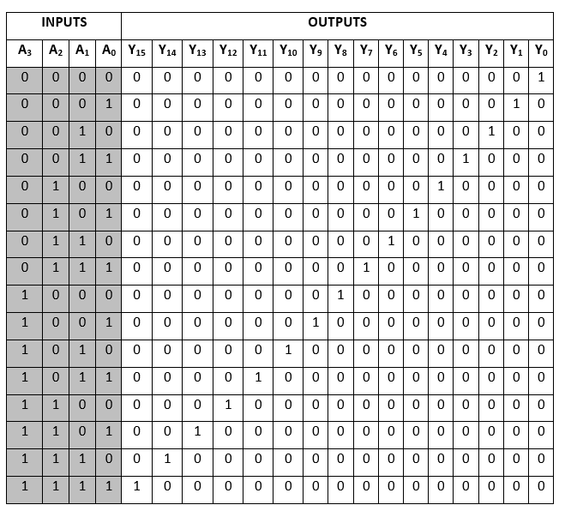
Decoders

Slide 14
Decoders
Can build a decoder by smaller decoders
A
O₀
0
B
S₂
O₁
1
B
C
S₁
O₂
3:8
O₃
2
D
S₀
dec
O₄
3
O₅
A
S₃
4
O₆
5
Enb
O₇
B
S₂
6
4:16
7
C
S₁
dec
8
C
9
O₀
D
S₀
10
B
S₂
O₁
1
1
O₂
12
C
S₁
3:8
O₃
13
D
S₀
dec
O₄
14
O₅
15
D
Enb
O₆
O₇
Enb

Slide 15
Decoders
How to build a 5-32 decoder by using 4-16 and 2-4 decoders?

Slide 16
Decoders
Decoder: a more general term
Our focus was on “binary decoders”

Slide 17
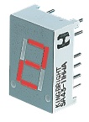
7-Segment Decoder
Seven-segment display:
7 LEDs (light emitting diodes), each one controlled by an input
1 means “on”, 0 means “off”
Display digit “3”?
Set a, b, c, d, g to 1
Set e, f to 0
a
f
b
g
e
c
d

Slide 18
7-Segment Decoder
C
0
C
C
5
C
6
1
C
C
4
2
C
3
C
C
C
C
C
C
C
0
1
2
3
4
5
6
BCD-to-7-segment
control signal
decoder
A
B
C
D

Slide 19
7-Segment Decoder
7-Segment Decoder:
Input is a 4-bit BCD code → 4 inputs (A, B, C, D).
Output is a 7-bit code (a,b,c,d,e,f,g) that allows for the decimal equivalent to be displayed.
Example:
Input: 0000_{BCD}
Output: 1111110 (a=b=c=d=e=f=1, g=0)
a
f
b
g
e
c
d

Slide 20
BCD-to-7Segment Truth Table
Digit
ABCD
abcdefg
Digit
ABCD
abcdefg
0
0000
1111110
8
1000
1111111
1
0001
0110000
9
1001
111X011
1010
XXXXXXX
2
0010
1101101
1011
XXXXXXX
3
0011
1111001
1100
XXXXXXX
4
0100
0110011
1101
XXXXXXX
5
0101
1011011
1110
XXXXXXX
6
0110
X011111
1111
XXXXXXX
7
0111
11100X0

Slide 21
K-maps
AB
A
AB
A
AB
A
CD
00
01
11
10
CD
00
01
11
10
CD
00
01
11
10
00
1
0
X
1
00
1
1
X
1
00
1
1
X
1
01
0
1
X
1
01
1
0
X
1
01
1
1
X
1
D
D
D
11
1
1
X
X
11
1
1
X
X
11
1
1
X
X
C
C
C
10
1
1
X
X
10
1
0
X
X
10
0
1
X
X
B
B
B
K-map for
a
K-map for
b
K-map for
c
A
AB
A
AB
A
AB
A
AB
CD
00
01
11
10
CD
00
01
11
10
CD
00
01
11
10
CD
00
01
11
10
00
1
0
X
1
00
1
0
X
1
00
1
1
X
1
00
0
1
X
1
01
0
1
X
0
01
0
0
X
0
01
0
1
X
1
01
0
1
X
1
D
D
D
D
11
1
0
X
X
11
0
0
X
X
11
0
0
X
X
11
1
0
X
X
C
C
C
C
10
1
1
X
X
10
1
1
X
X
10
0
1
X
X
10
1
1
X
X
B
B
B
B
K-map for
d
K-map for
e
K-map for
f
K-map for
g
a = A + B D + C + B' D'
b = A + C' D' + C D + B'
c = A + B + C' + D
d = B' D' + C D' + B C' D + B' C
e = B' D' + C D
f = A + C' D' + B D' + B C'
g = A + C D' + B C' + B' C

Slide 22
Encoder

Slide 23
Encoder
Encoder:
the inverse operation of a decoder.
Has 2^{n} input lines and n output lines.
The output lines generate the binary equivalent of the input line whose value is 1.
I0
z1
4-2
Binary
Encoder
I1
I2
z2
I3

Slide 24
Encoder
O₀
I₀
A
S₂
O₁
I₁
Z₂
A
O₂
I₂
B
S₁
3:8
O₃
I₃
8:3
Z₁
B
C
decoder
O₄
I₄
encoder
C
S₀
Z₀
O₅
I₅
O₆
I₆
O₇
I₇

Slide 25
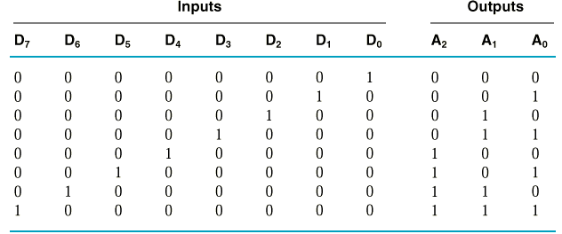
Encoder Circuit Design
Example:
8-3 Binary Encoder
A₀ = D₁ + D₃ + D₅ + D₇
A₁ = D₂ + D₃ + D₆ + D₇
A₂ = D₄ + D₅ + D₆ + D₇

Slide 26
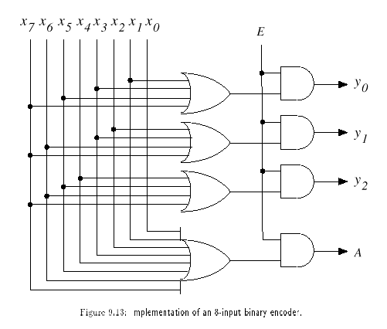
Encoder Circuit
With Enable
With Acknowledge

Slide 27
Encoder Circuit
With Enable
With Acknowledge

Slide 28
Encoder Circuit
With Enable
With Acknowledge

Slide 29
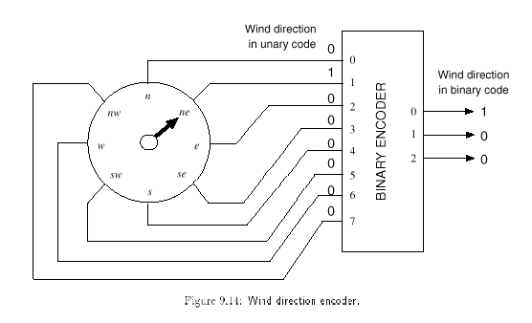
Application
The number of inputs: large
→ fewer lines

Slide 30
Encoder Design Issues
Only one input can be active at any given time.
If two inputs are active simultaneously, the output produces an undefined combination
(for example, if D₃ and D₆ are 1 simultaneously, the output of the encoder will be 111.
A₀ = D₁ + D₃ + D₅ + D₇
A₁ = D₂ + D₃ + D₆ + D₇
A₂ = D₄ + D₅ + D₆ + D₇

Slide 31
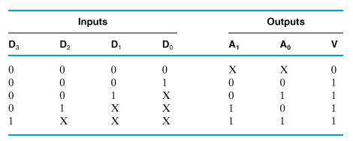
Priority Encoder
Multiple asserted inputs are allowed; one has priority over all others.

Slide 32
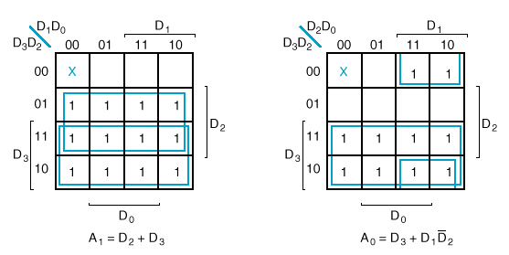
K-Maps

Slide 33
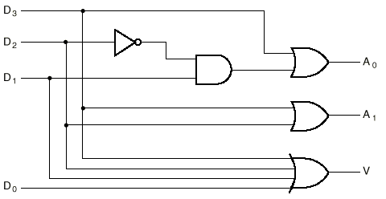
Circuit

Slide 34
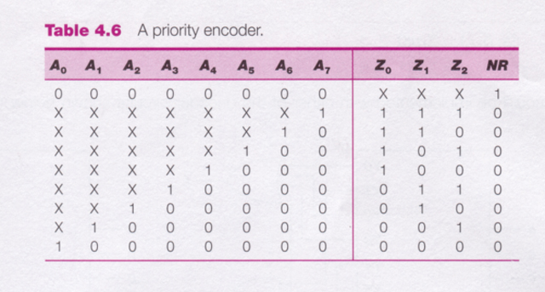
8-3 Priority Encoder

Slide 35
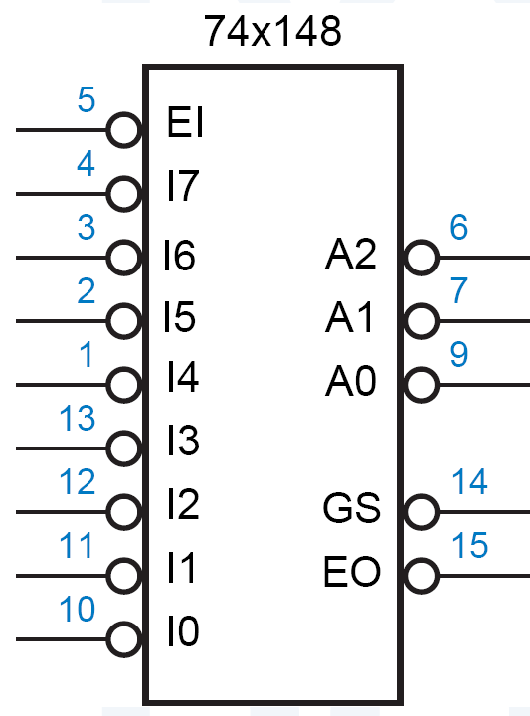
74x148
Features:
inputs and outputs are active low.
EI_L must be asserted for any of its outputs to be asserted.
GS_L is asserted when the device is enabled and one or more of the request inputs is asserted. (“Group Select” or “Got Something.” )
EO_L is an enable output designed to be connected to the EI_L input of another ’148 that handles lower-priority requests.
It is asserted if EI_L is asserted but no request input is asserted; thus, a lower-priority ’148 may be enabled.

Slide 36
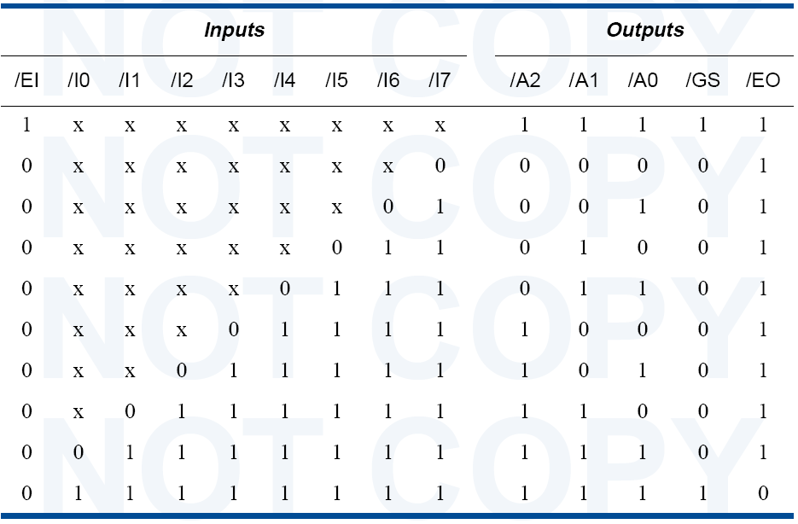
74x148 Truth Table

Slide 37
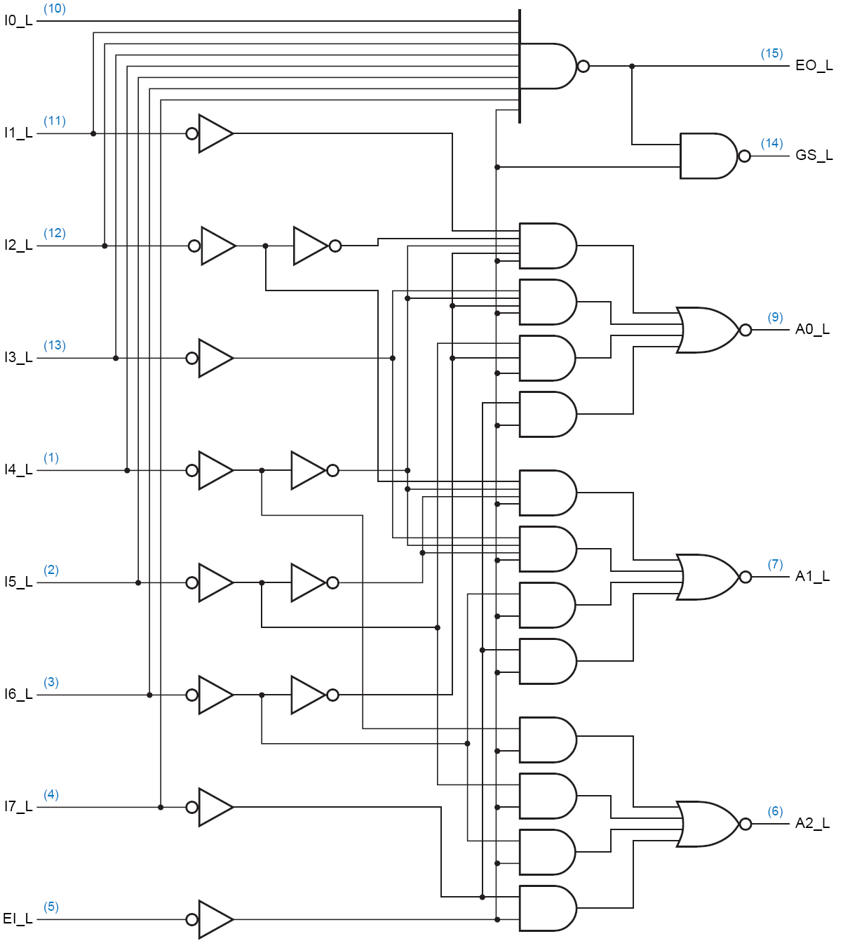
Circuit Diagram

Slide 38
Datasheets
http://users.otenet.gr/~athsam/database.htm
Some sample datasheets in the course site.

